Slide 1
Implier – Background
Ben Lackey

Slide 2
Definitions
Nearby
When several futures contracts are considered, the contract with the closest settlement date is called the nearby futures contract.
http://financial-dictionary.thefreedictionary.com/Nearby+futures+contract
Deferred
Among several different futures contracts, the one with the longest maturity. For example, given three futures contracts, one expiring in March, one in June, and one in September, the deferred futures is the one expiring in September.
http://financial-dictionary.thefreedictionary.com/Deferred+Futures

Slide 3
Trading the Spread
Buy the Spread, Bull Spread, Carry
Long the nearby month, short the deferred month
Sell the Spread, Bear Spread, Rollover
Short the nearby month, long the deferred month

Slide 4
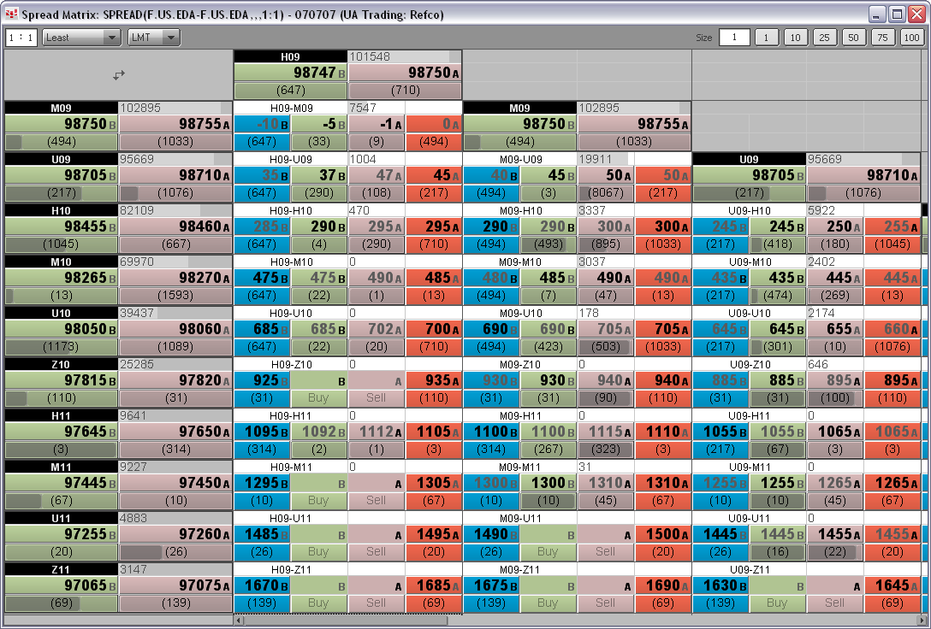
Spread Matrix in CQG

Slide 5
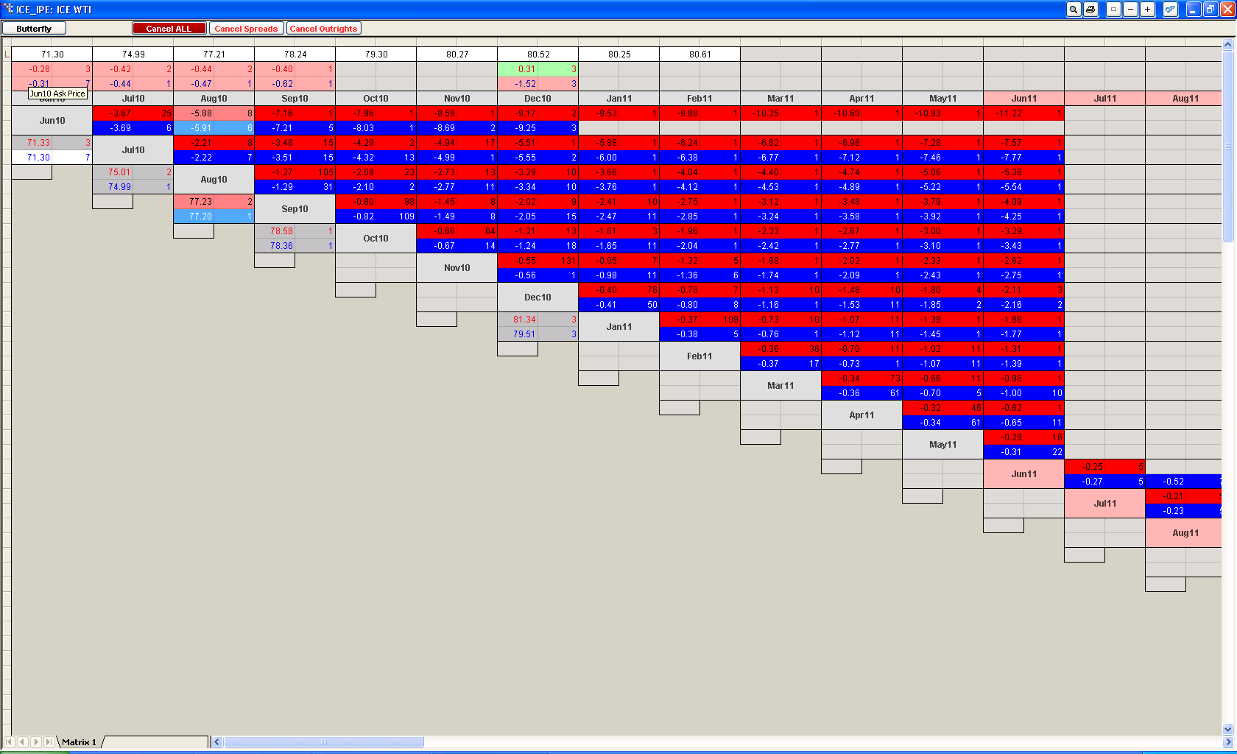
TT Spread Matrix

Slide 6
Spread Matrix with No Implied Volume
March
Bid
150x95.50
Ask
March/June
June
Bid
Ask
050x00.10
Bid
100x95.40
Ask
March/September
June/September
September
Bid
Ask
Bid
Ask
Bid
100x95.25
Ask

Slide 7
Spread Matrix with Implied Volume
March
Bid in Nearby – Ask in spread = Implied OUT bid in deferred
Bid
150x95.50
Ask
March/June
June
Bid
Ask
050x00.10
Bid
100x95.40
050x95.40
Ask
March/September
June/September
September
Bid
Ask
Bid
Ask
Bid
100x95.25
Ask

Slide 8
ICE
1st Generation implied volume supported
https://icelive.theice.com/ice_files/ICELivePro_enhancements.pdf

Slide 9
LIFFE - EURIBOR
1st Generation implied volume supported
http://www.nyse.com/pdfs/6471_LRS.pdf
The ArcaBook market data feed for NYSE Liffe also disseminates ‘Implied Out’ prices. Indeed, the LIFFE CONNECT platform supports both Implied Ins and Implied Outs prices.
‘ Implied Ins’ are prices in a strategy market derived from prices in the associated outright markets. They are calculated by the Trading Host but not disseminated.
‘ Implied Outs’ are prices in an outright market derived from prices in one strategy and prices in associated legs of the strategy. Although the LIFFE CONNECT. Trading Host continuously calculates ‘implied out’ prices, it only transmits ‘implied out’ prices when they are equal to or better than the Best price in the central Order Book.

Slide 10
CME
1st and 2nd Generation implied volume supported
http://www.cmegroup.com/globex/files/ImpliedPriceOverview.pdf

Slide 11
CME – Implied In
1. There is a Bid in SIZ6 at 13955.
2. There is an Ask in SIG7 at 14025.
3. This creates an Implied IN Bid in the Silver calendar spread SIZ6-SIG7 at -70.
Implied IN Bid in nearby/deferred spread = Bid in nearby – Ask in deferred

Slide 12
CME – Implied Out Bid
1. There is a Bid in SIZ6 at 13955.
2. There is an Ask in the Silver calendar spread of SIZ6-SIG7 at -74.
3. This creates an Implied OUT Bid in SIG7 at 14029.
4. All implied OUT bids are rounded down to the next standard tick.
5. Implied OUT Bid is created in SIG7 at 14025.
Implied OUT bid in deferred = Bid in nearby – Ask in spread of nearby/deferred

Slide 13
CME – Implied Out Ask
1. There is an Ask in SIZ6 at 13955.
2. There is a Bid in the Silver calendar spread of SIZ6-SIG7 at -74.
3. This calculates an Implied OUT Ask in SIG7 at 14029.
4. All implied OUT asks are rounded up to the next standard tick.
5. Implied OUT Bid is created in SIG7 at 14030.
Implied OUT ask in deferred = ask in nearby – bid in spread nearby/deferred

Slide 14
CME – 2nd Generation Implied
1. There is an Implied OUT Bid in the SIZ6 at 14010.
2. There is a real order for a 2-lot Ask in the SIF7 at 13995.
3. This creates an Implied 2nd Gen IN Bid order in the SIZ6-SIF7 at 15.
2nd generation implied IN bid in spread = implied bid in nearby – ask in deferred

Slide 15
Generalizing
Implied Bid in spread = Bid in nearby – Ask in deferred
Implied Ask in spread = Ask in nearby – Bid in deferred
Implied Bid in deferred = Bid in nearby – Ask in spread
Implied Ask in deferred = Ask in nearby – Bid in spread

Slide 16
Pure Arbitrage
Implieds can result in multileg trades that give a price below the market price
This is an opportunity for pure arbitrage
Buying one of these multileg instruments gives a butterfly that needs unrolling
The trade can be unrolled at a later date provided the expiration is not immediate

Slide 17
Using Implied for an Execution Management System
Implieds can give volumes that would result in an immediate fill
This effectively allows traders to jump the queue
For traders willing to take on risk, implieds can be used to quickly enter the market potentially at an initial profit

